Slide 1
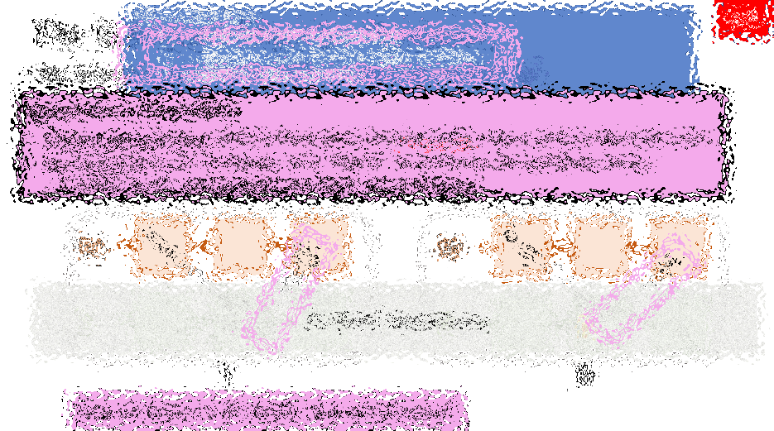
Drivechain – Overview and Misconceptions
Paul Sztorc
TAB Conf – Atlanta, GA
Jan 27, 2018 – v1.0
Feb 4th, 2018 – v2.0
Notes:
I blame myself
I thought that everyone understood all the issues
Solves
Scalabilty – both contention – infinite Bitcoin Blocksize safely – Milan
Governance
Protects Developers from Coercion – hard fork
Altcoin Competition – price
Furthermore, invested time explaining – so I assume that people understand the explanation.
Jorge Timon – sidechain requires miners to validate
Giacomo Zucco – Greg Slepak
Matt Corallo – multiplication error
…”further (drastically) reduce it by requiring users to potentially pay in excess of the value an attacker is willing to pay to keep their chain secure, on a recurring basis?”
Double-Downers
Compounding the issue – obvious for me – problems – easily solvable – why don’t they
When you solve everyone’s problem, and people still complain, what logical conclusion can you even draw from that? That people prefer to have the problems, to make themselves more important. It certainly doesn’t need to be a conspiracy -- as Giacomo keeps misrepresenting Daniel Krawisz’s argument.
Bias motivated reasoning. People prefer to believe the Roger Ver is wrong about big blocks because they don’t like him personally, or because they think Roger is annoying them.
Miracle Pill

Slide 2
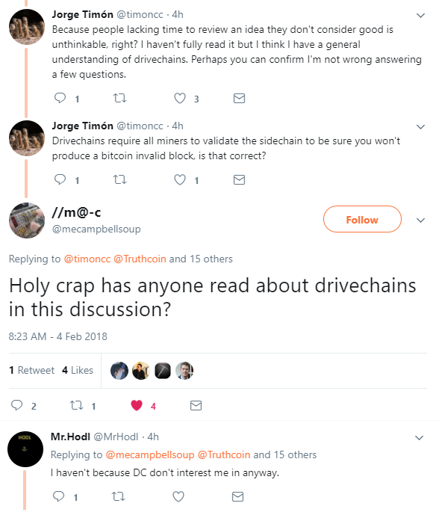
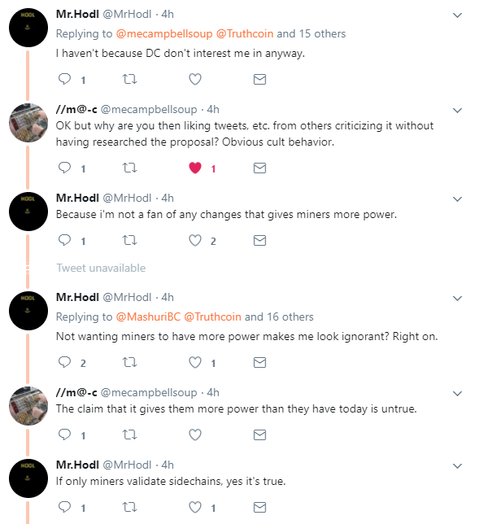
Notes:
It is malice, not stupidity.
You could at most say that DC allows users to gamble that I am correct about a given miner-strategy being most profitable.

Slide 3
“Drivechain gives miners more power”
“Optionality” Criterion
“DC allows users to choose to make a certain gamble: the risk is that I [Paul Sztorc] am correct about a given miner-strategy being objectively the most profitable, the reward is unlimited technical flexibility without the need to bother everyone else (with a hard fork)”
“Letting users gamble that a mining-policy is objectively the most profitable” -- Indistinguishable from the Lightning Network
Notes:
It is malice, not stupidity.
I try to help explain Drivechain to people -- cherry pick this little thing – common to all sidechain designs -- without understanding the issues.
I think these people are a lost cause

Slide 4
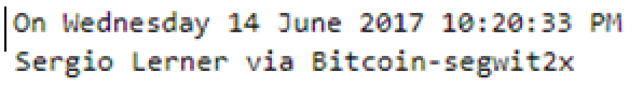
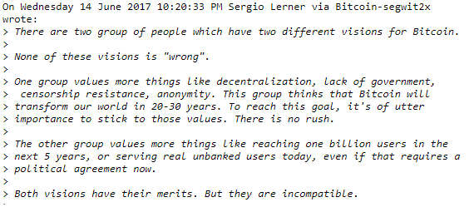
The Problem – People are Different

Slide 5
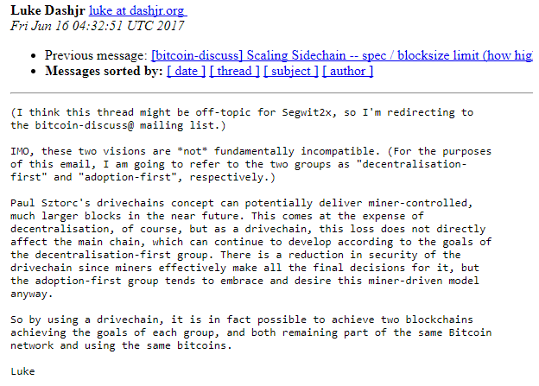
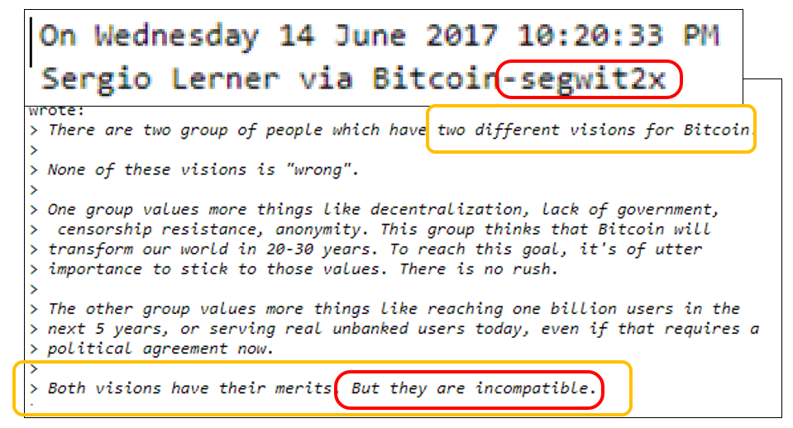
Drivechain?

Slide 6

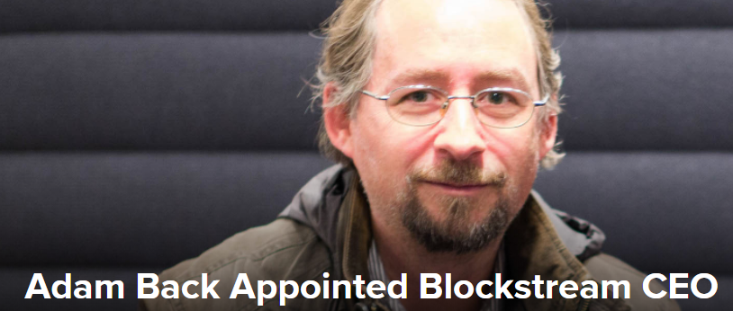
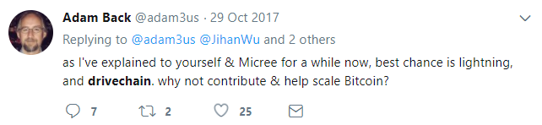

Drivechain?
Stickied by theymos -- top of /r/bitcoin for two weeks

Slide 7
Agenda
Review: What are Sidechains?
‘Drivechain’ Specifically
Puzzle Pieces / Existing Ingredients
Achieving “Opt-In”
Fusion of Ideas –> Slow, Transparent Withdrawals
Security Model of Drivechain – often misunderstood
Blind Merged Mining
Helpful Comparisons

Slide 8
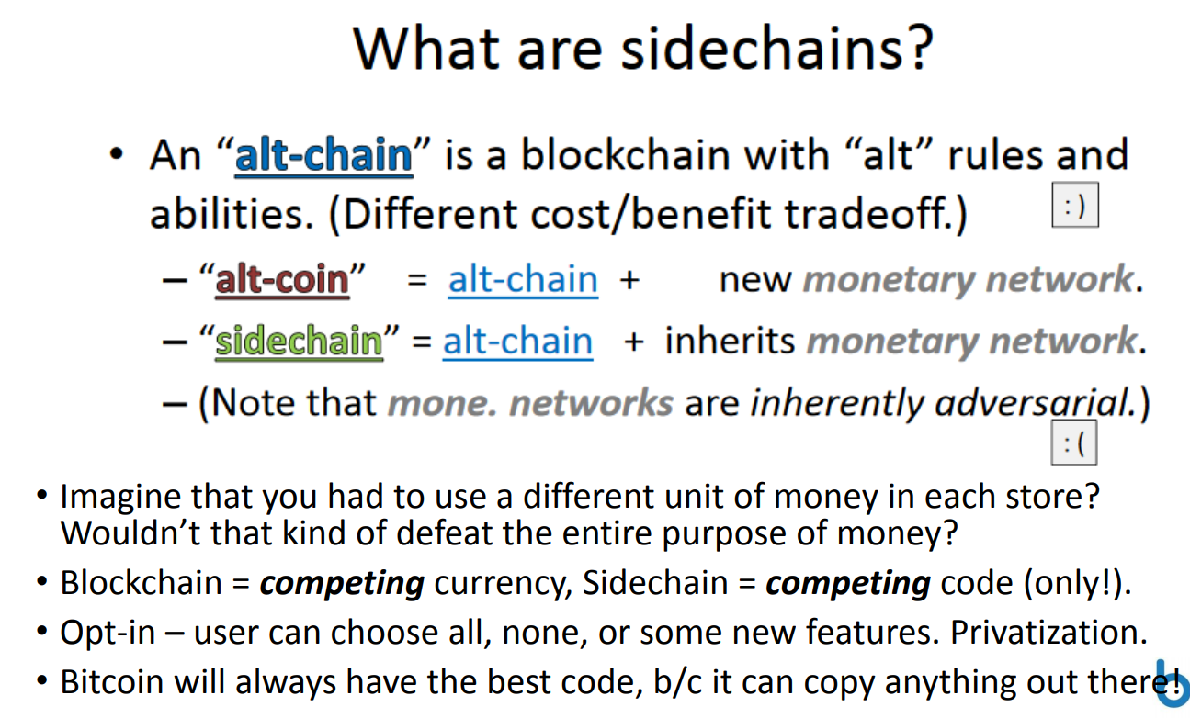
What are sidechains?

Slide 9
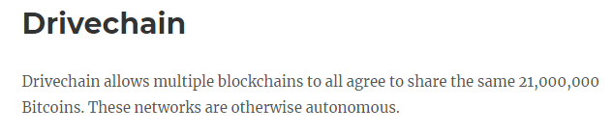
What are sidechains?
From Project Site www.drivechain.info

Slide 10
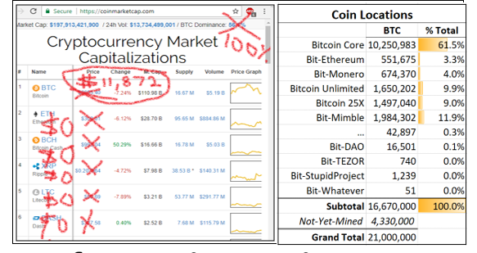
What’s the point?
Popularity → d(location), not d(price)
When I made this, BTC was at $6,800
Bitcoin Cash
Notes:
If roger pumps Bitcoin Cash

Slide 11

What’s the point?
Crush the Alts
Value – Metcalfe’s Law
Blockspace & Security – Alt Tx Fees to Our Miners
Existential Threat
Scalability Contention
True cause: people are different (vs blockchain 100% consensus)!
Lightning network does not solve scalability contention
“miles per gallon” (scalability) vs. “fuel tank size [gallons]” (decentralization)
“Scalability” debate isn’t about scalability. It is about decentralization -- how much a node should cost to run.
Roger / Luke
Notes:
All value concentrated in the winning coin = ($$__$$)
No ‘intrinsic value’ in Altcoins, except as collectibles (DOGE / PepeCash).
More total value (Metcalfe’s Law). No switching costs / transaction frictions.
No more technological risk – investors in BTC will know it will always have the best tech.
Infinite Blockspace + More Hashrate Security
Altcoins currently provide users with a de facto ‘Unlimited Blocksize’.
But the txn fees (among other things) on Alts, don’t go to our Bitcoin Miners…
…so SC improve over this –unlimited blocksize + fees go to Bitcoin Miners.
However unlikely – then Bitcoin loses
Some ppl transact a lot, others don’t. Some can afford expensive node, others can’t.

Slide 12
Part 2 – Drivechain How do we make this wonderous technology?

Slide 13
Existing Ingredients -- get us Mostly There
Altcoins Themselves – LTC, Eth – would already be sidechains if not for…
…they print their own money.
…they reliably have their own miners/consensus.
…they lack accounting rules for interchain transfers.
Mainchain balance down by 1 → Sidechain balance up by 1
Sidechain balance down by 1 → Mainchain balance up by 1
Embedded Consensus – Counterparty, Colored Coins
Inherits Consensus (“Merged” Mining)
Asymmetric Protocol “Child Watches Parent” – “deposits” tightly controlled
Instant Atomic Cross-Chain Swaps
Zero-trust, simple, and fast… (1 block w/o LN, immediate w/ LN)
…but not ‘pegged’ (not forced to be at desired 1:1 fixed rate).
coinbase txn
miners
transfers
a
b
BTC
crazy
XCP
(You deposit 10 Core-BTC into RSK, making it 10 Ethereum-BTC. But will anyone willingly give you 10 Core-BTC for Eth-BTC?)
(We want all the Altcoin-related price risk to be hedged away.)
Notes:
Stealing a lot of work! After all, someone already made Litecoin, Ethereum.

Slide 14
Before I talk about the pegged main-to-side xfers, I need to talk about some other things.
Part 2b – Achieving “Opt-In”
Warning: Advanced Blockchain Theory Ahead!
8 difficult slides

Slide 15
The Sidechain Must be Optional
1/8
By definition, the sidechain must be optional.
Mainchain must process withdrawals “blind” to what is going on in the sidechain.
Otherwise, it would be a de facto hard fork (which is exactly what we are trying to avoid in the first place). Can’t be “opt in” unless you are “out” by default.
But, then, an invalid withdrawal must be treated exactly the same as a valid one! There is no basis for discriminating between them.
M
A
M
A
B
E
B
F
H
B
C
B
C
S
S
D
E
D
F
I
II
Two Possible Histories
Time
Time

Slide 16
The Sidechain Must be Optional
2/8
Side-to-main xfers:
… must be free to go anywhere.
… cannot be constrained by node validation.
(These are pros, not cons!)
But, if txn is unrestrained, anyone can immediately steal its BTC….
Fortunately, we can constrain S2M by SPV validation – ie , if scarce (non-reusable) proof of work has been done on S2Ms.
By definition, the sidechain must be optional.
Mainchain must process withdrawals “blind” to what is going on in the sidechain.
Otherwise, it would be a de facto hard fork (which is exactly what we are trying to avoid in the first place). Can’t be “opt in” unless you are “out” by default.
But, then, an invalid withdrawal must be treated exactly the same as a valid one! There is no basis for discriminating between them.
Slepak Error – No main:fullnode constraints on miners. False.
M
A
M
A
B
E
B
Train Metaphor
F
H
B
C
B
C
S
S
D
E
D
F
I
II
Two Possible Histories
Time
Time
Notes:
Here’s your big excuse – Paul

Slide 17

The Sidechain Must be Optional
3/8
Side-to-main xfers:
… must be free to go anywhere.
… cannot be constrained by node validation.
(These are pros, not cons!)
But, if txn is unrestrained, anyone can immediately steal its BTC….
Fortunately, we can constrain S2M by SPV validation – ie , if scarce (non-reusable) proof of work has been done on S2Ms.
By definition, the sidechain must be optional.
Mainchain must process withdrawals “blind” to what is going on in the sidechain.
Otherwise, it would be a de facto hard fork (which is exactly what we are trying to avoid in the first place). Can’t be “opt in” unless you are “out” by default.
But, then, an invalid withdrawal must be treated exactly the same as a valid one! There is no basis for discriminating between them.
Ignorance Mandate
If you want to know which withdrawals are side:valid, then run the sidechain node.
ALL this tech is for the people who *don’t* want to run the sidechain node… …in other words, the people who don’t want to know.
M
A
M
A
B
E
B
F
H
The “Opt-In” Veil of Ignorance
B
C
B
C
S
S
D
E
D
F
I
II
One of these is SC-theft. But which one?

Slide 18

The Bad News
4/8
Users Affect Miners Affect Users (UsAMAUs)
Some users → All Miners [intransigent minority; uasf] All Miners → All users [“Am I getting paid?”; chain status]
If miners are persuaded to follow different [but compatible] rules, then you’re stuck with them as well!
Side-to-main xfers:
… must be free to go anywhere.
… cannot be constrained by node validation.
(These are pros, not cons!)
But, if txn is unrestrained, anyone can immediately steal its BTC….
Fortunately, we can constrain S2M by SPV validation – ie , if scarce (non-reusable) proof of work has been done on S2Ms.
By definition, the sidechain must be optional.
Mainchain must process withdrawals “blind” to what is going on in the sidechain.
Otherwise, it would be a de facto hard fork (which is exactly what we are trying to avoid in the first place). Can’t be “opt in” unless you are “out” by default.
But, then, an invalid withdrawal must be treated exactly the same as a valid one! There is no basis for discriminating between them.
Ignorance Mandate
If you want to know which withdrawals are side:valid, then run the sidechain node.
ALL this tech is for the people who *don’t* want to run the sidechain node… …in other words, the people who don’t want to know.
We want “opt in”.
Ergo, people must be OUT by default. But ‘UsAMAUs’ is constantly sucking everyone in.
How to fight it?
M
A
M
A
B
E
B
F
H
The “Opt-In” Veil of Ignorance
B
C
B
C
S
S
D
E
D
F
I
II
One of these is SC-theft. But which one?
Notes:
Famous biologist and Chozo historian
As if someone had held down the A button, charging up their

Slide 19
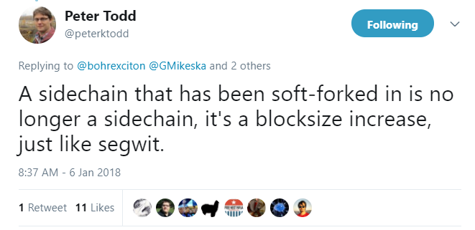
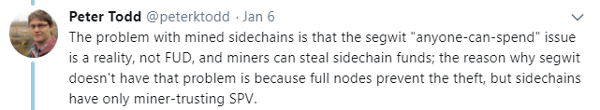
The Sidechain Must be Optional
5/8
Side-to-main xfers:
… must be free to go anywhere.
… cannot be constrained by node validation.
(These are pros, not cons!)
But, if txn is unrestrained, anyone can immediately steal its BTC….
Fortunately, we can constrain S2M by SPV validation – ie , if scarce (non-reusable) proof of work has been done on S2Ms.
By definition, the sidechain must be optional.
Mainchain must process withdrawals “blind” to what is going on in the sidechain.
Otherwise, it would be a de facto hard fork (which is exactly what we are trying to avoid in the first place). Can’t be “opt in” unless you are “out” by default.
But, then, an invalid withdrawal must be treated exactly the same as a valid one! There is no basis for discriminating between them.
Ignorance Mandate
If you want to know which withdrawals are side:valid, then run the sidechain node.
ALL this tech is for the people who *don’t* want to run the sidechain node… …in other words, the people who don’t want to know.
Mandatory
several optional “smart contracts” have already been forked into BTC (RSK federation, XCP, Mt Gox website).
M
A
M
A
B
E
B
F
H
The “Opt-In” Veil of Ignorance
B
C
B
C
S
S
Mandatory sidechain = today called “extension block”
Preceding tweet
D
E
D
F
I
II
Problem with extension blocks, is ironically, miners can’t steal from them, ie that ext-blocks force people to know.
One of these is SC-theft. But which one?

Slide 20
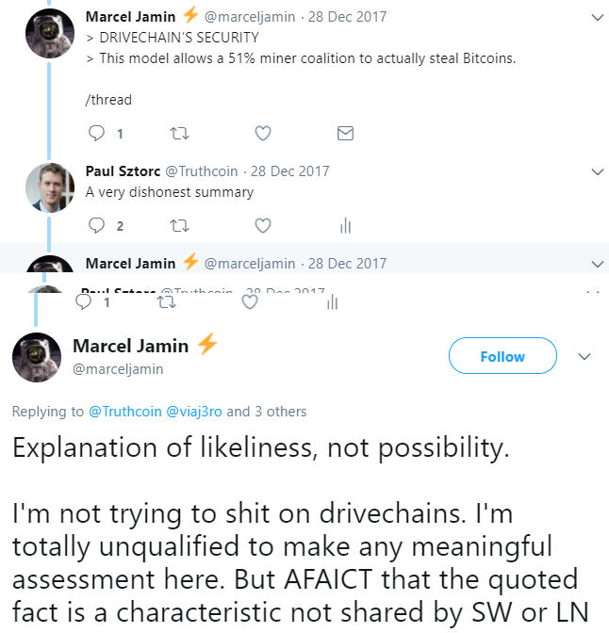
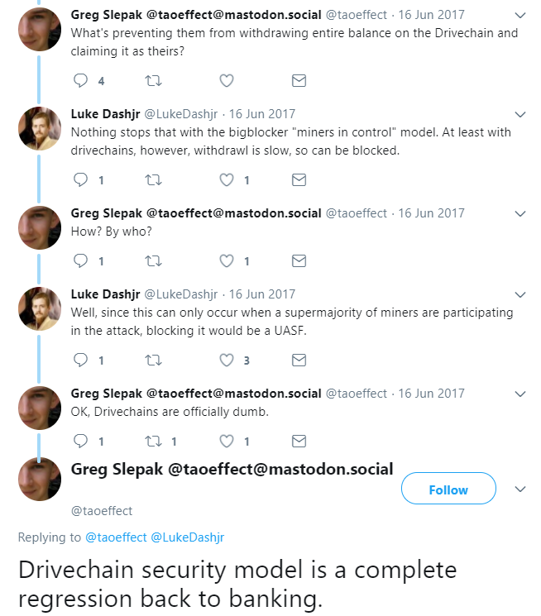
Mutually-Exclusive Criteria
6/8
mandatory
Sidechain must be optional
PT’s point is even true for zk-snarks / CoinWitness – those would be a non-optional ‘evil fork’ (soft-hardfork)…albeit a hopefully irrelevant one.

Slide 21
“Stealing” Bitcoin
7/8

Slide 22
Mutually-Exclusive Criteria
8/8
Peter Todd / Luke Dashjr: miner-theft should be possible . Main:users must be able to ignore sidechain. Main:users must believe that main:miners will not change the main:chain as a result of what happens on a sidechain. Marcel / Slepak: want miner-theft to be impossible.
(Peter Todd / Luke-Jr Happy)
Optional
Zone 2
Zone 1
(Marcel / Slepak Happy)
100%
0% Optional 100% Mandatory
100% Secure – Miner-theft is “Impossible”
Secure
0%
100%

Slide 23
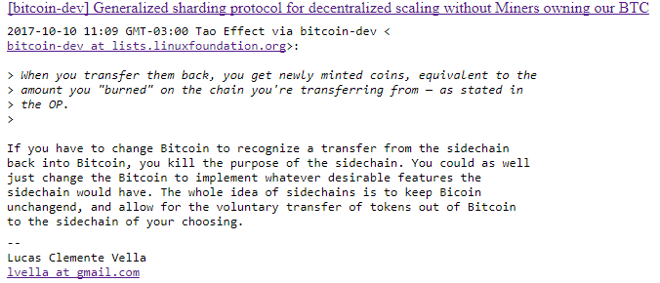
Mutually-Exclusive Criteria
Peter Todd / Luke Dashjr: miner-theft should be possible . Main:users must be able to ignore sidechain. Main:users must believe that main:miners will not change the main:chain as a result of what happens on a sidechain. Marcel / Slepak: want miner-theft to be impossible.
(Peter Todd / Luke-Jr Happy)
Optional
Zone 2
Zone 1
(Marcel / Slepak Happy)
100%
0% Optional 100% Mandatory
100% Secure – Miner-theft is “Impossible”
Secure
0%
100%

Slide 24
Revisited

Slide 25
Revisited
the sidechain to be optional….
…thus protecting mainchain users from being kept in the dark about the status of their mainchain payments.

Slide 26
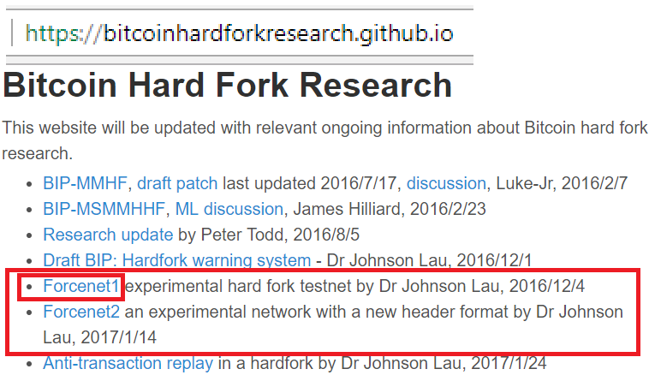
Revisited
ForceNet
forces full nodes to validate all sidechain rules, preventing theft…
the sidechain to be optional….
…but forcing mainchain users to upgrade, as in a “hard fork”, or “evil fork” or “Soft-hardfork”, like extension blocks (incl SegWit).
…thus protecting mainchain users from being kept in the dark about the status of their mainchain payments..
Because of ‘UsAMAUs’, SegWit is an ext-block / “evil fork” and NOT 100% Opt-In.
ForceNet = mandatory sidechain + 51% censorship attack.
Notes:
Which is exactly why it *IS* 100% secure.

Slide 27
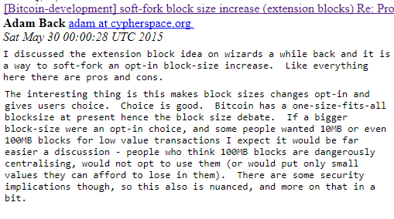
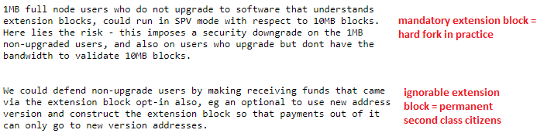
Evil Fork (Hard Fork) or Permanent Inferiority
Dr. B figured out a lot of this back in 2014
optional
Soft fork, not yet activated
Soft fork activated a long time ago
evolution of ext-block design
21 million coin limit
secure
Mandatory extension block requires you to know.
Optional extension block – pretty secure, but one way – not pegged and thus not as useful.

Slide 28
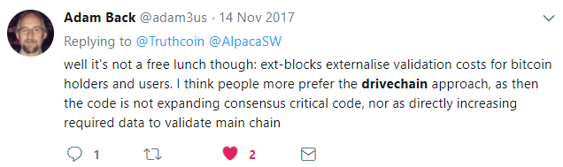
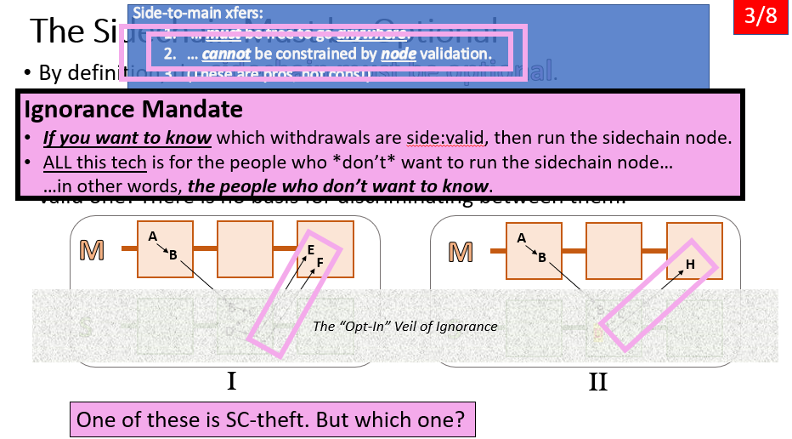
Dr. B – Extension Block vs Drivechain
Drivechain: mandatory trivialities (for miners). Optional everything (for users).
optional
then, do what we can for security
evolution of drivechain – emphasizing opt-in
secure

Slide 29
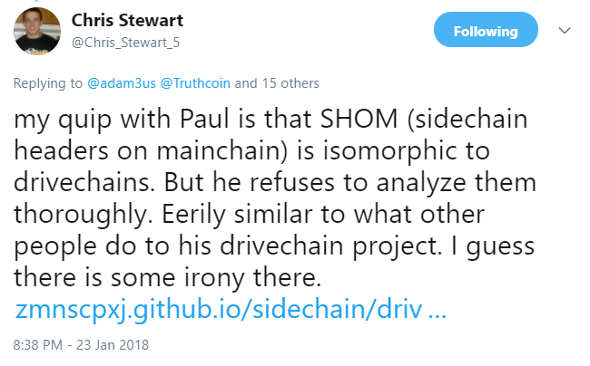
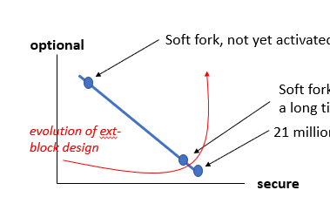

Dr. B – Extension Block vs Drivechain
Drivechain: mandatory trivialities (for miners). Optional everything (for users).
optional
then, do what we can for security
evolution of drivechain – emphasizing opt-in
Liked by Giacomo Zucco, CEO Blockchainlab.it
secure

Slide 30
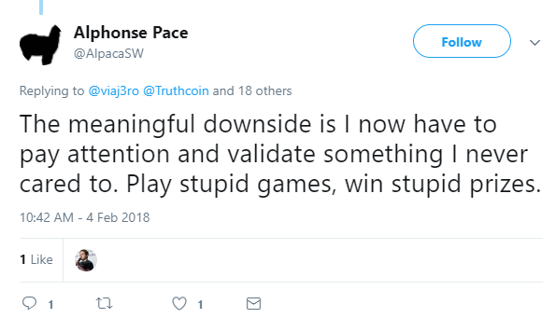
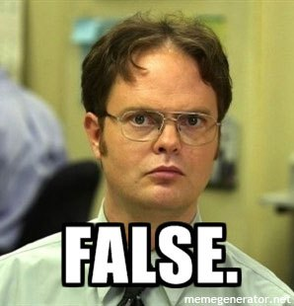
Misunderstood from Both Sides
Liked by Giacomo Zucco, CEO Blockchainlab.it
Alp prefers it to be Optional
…even though it already is.

Slide 31
Misunderstood from Both Sides
Does he know :
* …he disagrees with Todd/ Dashjr / Alp ?
* this arg would disqualify ALL sidechain designs ?
MrHodl prefers it to be Mandatory (ie, node-secured)

Slide 32
Misunderstood from Both Sides
sidechains.
Does he know :
* …he disagrees with Todd/ Dashjr / Alp ?
* this arg would disqualify ALL sidechain designs ?
MrHodl prefers it to be Mandatory (ie, node-secured)
Notes:
Theres a very real sense in which he is saying …
Full node or bust.

Slide 33
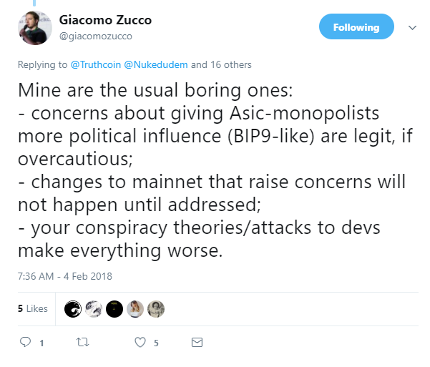
A Crazy UsAMUs

Slide 34
A Bizarre UsAMUs
Two Models
Desire for Power
Profit Motive
Miner’s Decisions
Miner’s Decisions
SegWit Withheld – Profit Motive?
Scaling 3 – too little too late
2016 in context – rise of Eth / Alts
Earnest confusion about how to
Profit-maximize, breakdown of Communication
Scaling 2 – Miner roundtable

Slide 35
A Bizarre UsAMUs
Two Models
Desire for Power
Profit Motive
Miner Mind
Withhold SegWit → Increase likelihood of Blocksize Increase → More Money
Miner’s Decisions
Miner’s Decisions
SegWit Withheld – Profit Motive?
Scaling 3 – too little too late
2016 in context – rise of Eth / Alts
Earnest confusion about how to
Profit-maximize, breakdown of Communication
Scaling 2 – Miner roundtable

Slide 36
A Bizarre UsAMUs
Actually not a UsAMUs
Only the speculators are affected.
Just the “but SC users might lose the gamble” arg in disguise.
Two Models
Desire for Power
Profit Motive
Miner’s Decisions
Miner’s Decisions
SegWit Withheld – Profit Motive?
Scaling 3 – too little too late
“DC allows users to choose to make a certain gamble: the risk is that I [Paul Sztorc] am correct about a given miner-strategy being objectively the most profitable, the reward is unlimited technical flexibility without the need to bother everyone else (with a hard fork)”
2016 in context – rise of Eth / Alts
Earnest confusion about how to
Profit-maximize, breakdown of Communication
Scaling 2 – Miner roundtable
Notes:
No logical foundation

Slide 37
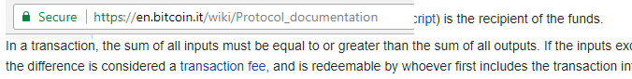
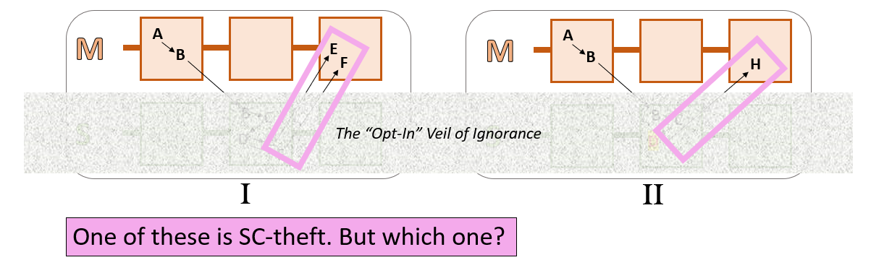
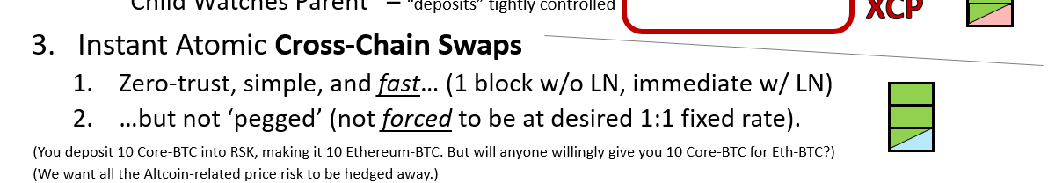
Fusion of Ideas…
Mainchain txn rules:
Already prevent counterfeiting.
Can never (by definition) enforce sidechain rules.
(Theft-notwithstanding a “peg” has achieved itself).
Our unsolved problem is theft, not “peg”.
ACCS – no theft,
easy to use,
and fast…
Notes:
Each txn already spends all of its inputs.

Slide 38
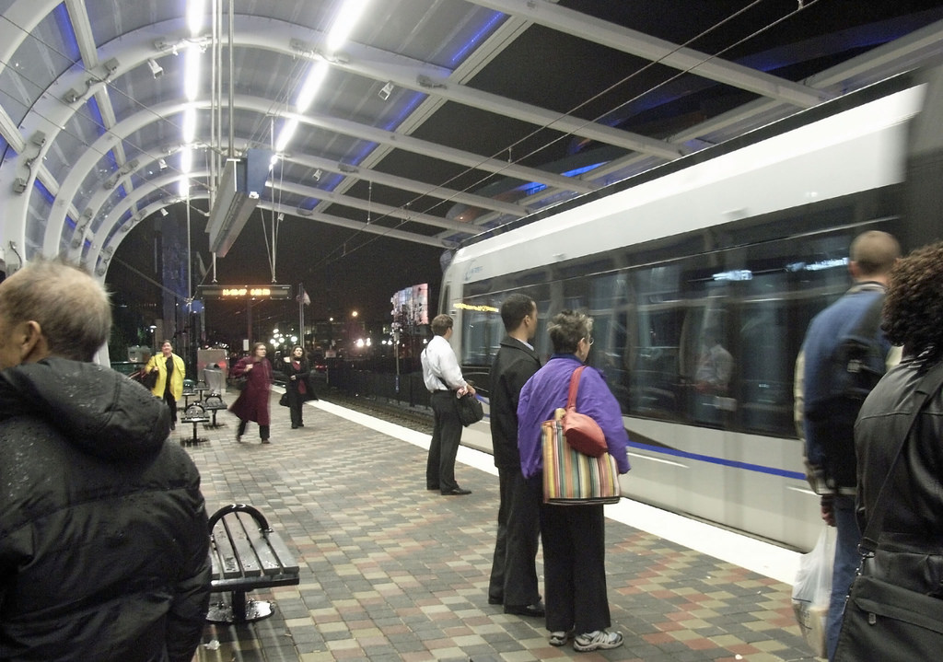
Drivechain -- Long Slow Transparent Vulnerable Withdrawals
optional
Slow, at least 3 months, but pegged (1:1 rate).
Recall, users get speed elsewhere:
main-to-side “deposits” via Embedded Consensus
((main→side), (side→main)) trades via atomic swaps.
Cross-chain LN
Users shouldn’t be using the slow withdrawals –equivalent to having a legal contract enforced. (Similar to “closing a LN channel” – only done if something goes wrong.)
Batch the withdrawals.
secure
Notes:
Greg Maxwell not smart enough to figure it out

Slide 39
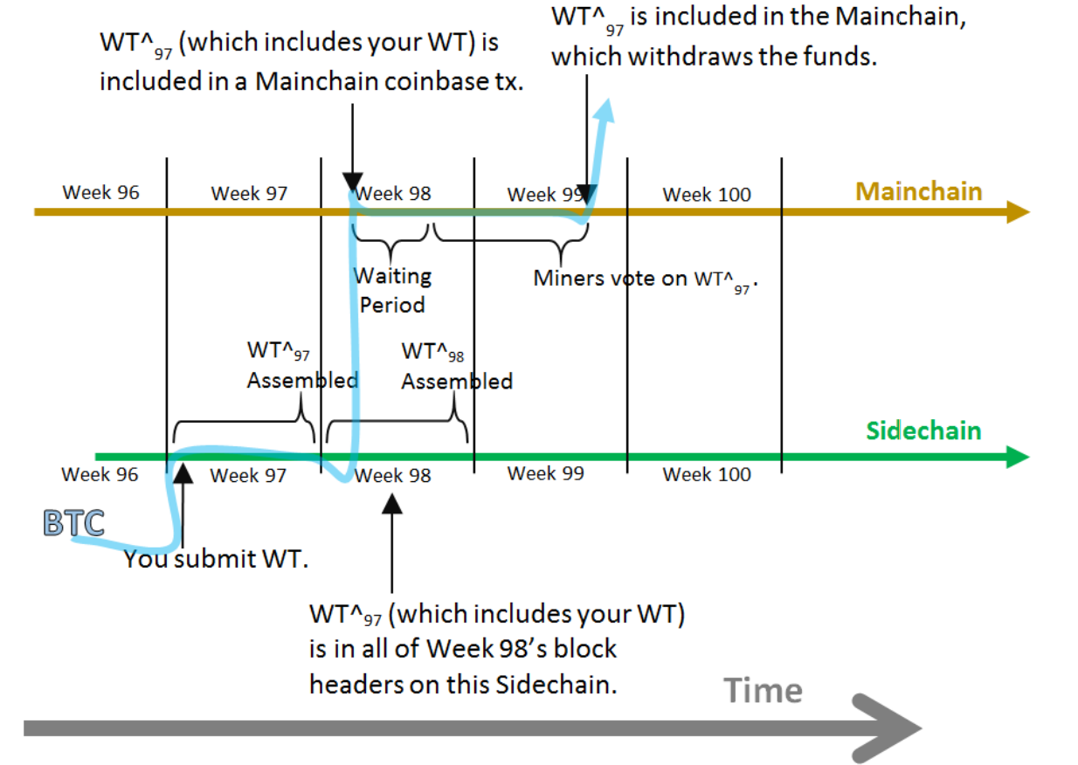
Batch the Withdrawals

Slide 40
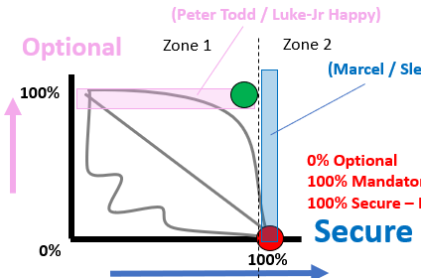
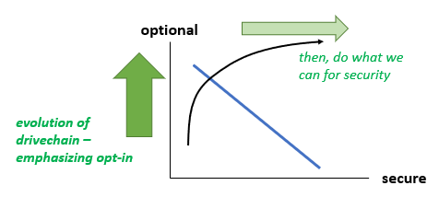
Part 3 – Security Model

Slide 41
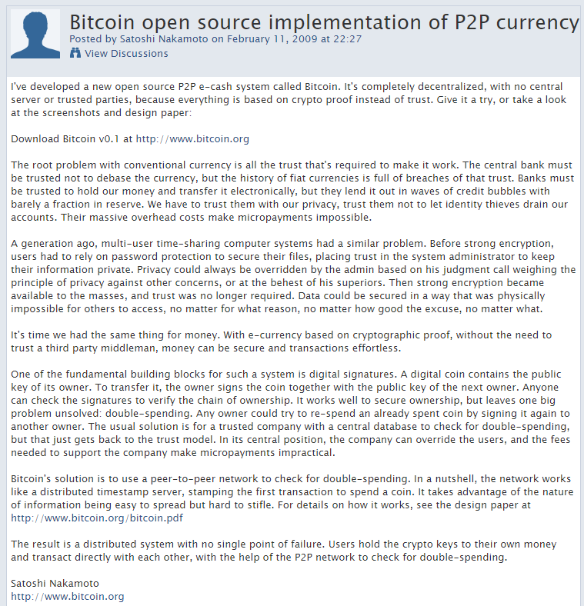
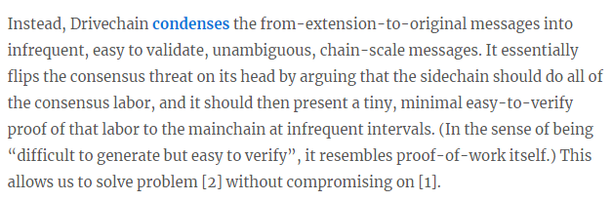
Part 3 – Security Model
Only b/c PoW
From: drivechain.info/faq

Slide 42
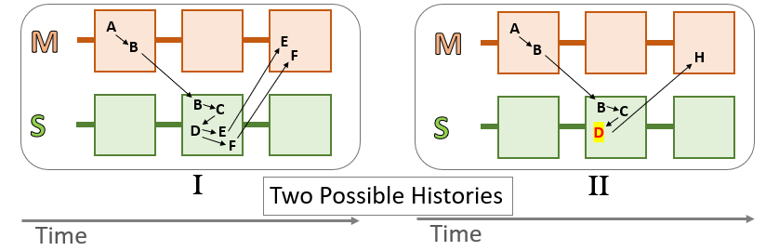
Remember Our Example?

Slide 43
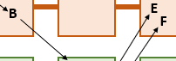
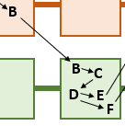
All Aboard!!
Train One
Remember…?

Slide 44
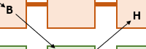

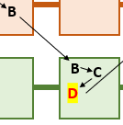
All Aboard!!
Train Two
And also…?
→ H

Slide 45
All Aboard!!
Train Three
X
Another Theft-Attempt
→ Z
→ K

Slide 46

All Aboard!!
Train Four
X
A third theft-attempt
→ X

Slide 47
Per Sidechain, Only One Traincar can advance at a Time
The others move back.
(each main:block)
[E,F]
t = 9
[H]
[Z,K]
[E,F]
Through t=16
[H]
START
[X]
[Z,K]
[X]
Sidechain #6

Slide 48
Per Sidechain, Only One Traincar can advance at a Time
The others move back.
t = 10
[E,F]
[H]
START
[Z,K]
[X]
Sidechain #6

Slide 49
Per Sidechain, Only One Traincar can advance at a Time
The others move back.
t = 11
[E,F]
[H]
START
[Z,K]
[X]
Sidechain #6

Slide 50
Per Sidechain, Only One Traincar can advance at a Time
The others move back.
t = 12
[E,F]
[H]
START
[Z,K]
[X]
Sidechain #6

Slide 51
Per Sidechain, Only One Traincar can advance at a Time
No action taken.
Abstain
t = 13
[E,F]
[H]
START
[Z,K]
[X]
Sidechain #6

Slide 52
Per Sidechain, Only One Traincar can advance at a Time
Everything moves back.
Alarm
t = 14
[E,F]
[H]
START
[Z,K]
[X]
Sidechain #6

Slide 53
Per Sidechain, Only One Traincar can advance at a Time
The others move back.
t = 15
[E,F]
[H]
START
[Z,K]
[X]
Sidechain #6

Slide 54
Per Sidechain, Only One Traincar can advance at a Time
The others move back.
t = 16
[E,F]
[H]
START
[Z,K]
[X]
Sidechain #6

Slide 55
Finish Line = Withdraw BTC
If a train car advances 13,150 places (3 months confs) → ‘finish line’
“Passengers” can “disembark”.
“Its txns” can “be included [in a main:block]”.
BTC has moved from sidechain to mainchain, finally.
Trains “expire” after 26,300 blocks (6 months).
Train One
Finish!
This info is now “costly” to make, but easy to verify (next slide). Just like PoW.
This is a de facto “SPV Proof” – the best so far.
13,150
[E,F]
[H]

Slide 56
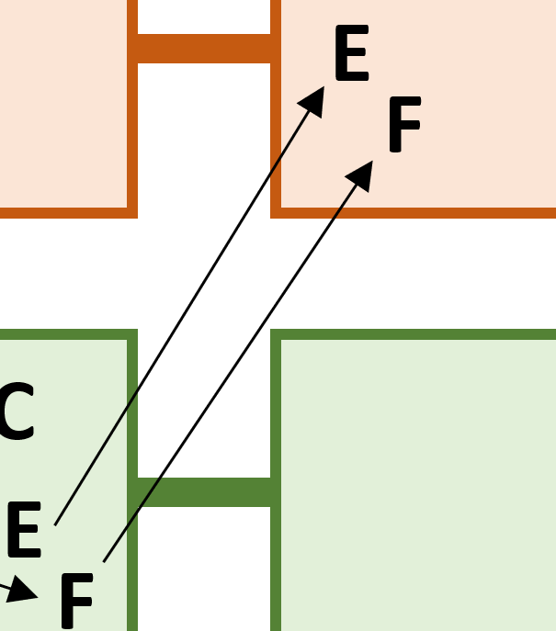
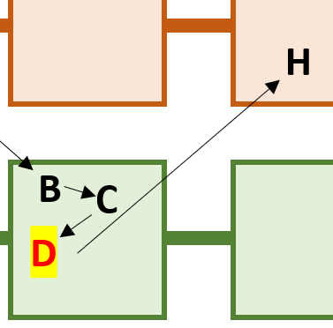
Easy to Verify
Many ways to do it, DC won’t force a particular way...because it can’t (remember the veil).
Meanwhile, sidechain should make it very easy to learn the “correct” withdrawal.
Include it in every sidechain header (for 6 months).
Include it as the left node in a compound Merkle tree.
Recall: mainchain has no idea which withdrawals are side:valid.
But (disinterested) main:users and main:miners can still:
Run sidechain in SPV mode, and examining the withdrawals there for stability and consistency.
“Ask a friend” who runs this sidechain.
Social proof – look at reputable authorities, social media.
Use the Alarm (mentioned earlier).
But, no idea which headers are valid
Full Sidechain Node | Drivechain “Monitoring” | Improvement Factor
2 GB per week (assuming current [1,4] MB limits) | One “bit” per 3 months (in equilibrium case) | 192,000,000
Notes:
Instead of actually getting 2 GB worth of data a week, you just need one “bit” – is everything ok or is something wrong.
If you want to know which withdrawals are side:valid, just run the sidechain node. This is ALL for people who *don’t* want to run the sidechain node (ie, the people who don’t want to know).
Still do m

Slide 57
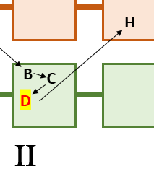

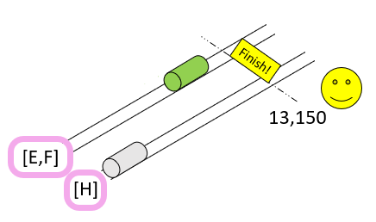
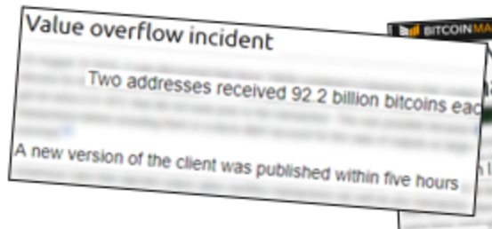
The UASF Defense [and threat of]
If users detect a bad withdrawal, they can choose to reject any block that includes it. (Ie, train arrives, but the doors don’t open, and passengers aren’t allowed to disembark.)
Plans to make this very easy in the UI – just a few clicks. ( +Box: Danger if not joined my economic majority. )
Users can take their time, and will never be surprised. Takes 1+ month to advance 4,000 spaces, which is (1/3) the required distance. – Compare to V.O.I. and March 2013 HF.
Miners don’t know if users plan to UASF-defend, until they do it (ie, users automatically bluff for free).
Since it won’t accomplish anything, why bother attacking? If zero attacks, it is free to defend. Ideal!
Notes:
Open the sidechains tab, and you’d be able to see all the trains in advance, and then you’d be able to say – “Don’t let those passengers into this country”

Slide 58
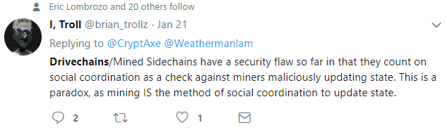
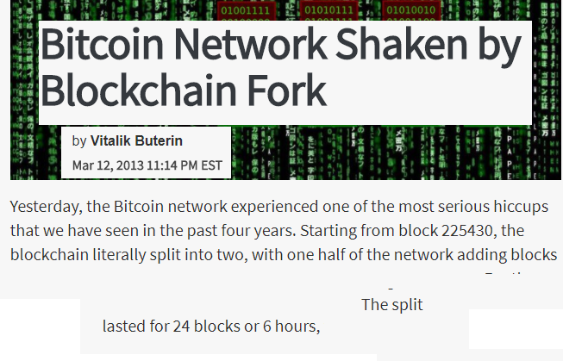
The UASF Defense [and threat of]
If users detect a bad withdrawal, they can choose to reject any block that includes it. (Ie, train arrives, but the doors don’t open, and passengers aren’t allowed to disembark.)
Plans to make this very easy in the UI – just a few clicks. ( +Box: Danger if not joined my economic majority. )
Users can take their time, and will never be surprised. Takes 1+ month to advance 4,000 spaces, which is (1/3) the required distance. – Compare to V.O.I. and March 2013 HF.
Miners don’t know if users plan to UASF-defend, until they do it (ie, users automatically bluff for free).
Since it won’t accomplish anything, why bother attacking? If zero attacks, it is free to defend. Ideal!
Previous “Paradoxes”
Same Process, but: 5-6 hours after vs 3 months before

Slide 59

The UASF Defense [and threat of]
If users detect a bad withdrawal, they can choose to reject any block that includes it. (Ie, train arrives, but the doors don’t open, and passengers aren’t allowed to disembark.)
Plans to make this very easy in the UI – just a few clicks. ( +Box: Danger if not joined my economic majority. )
Users can take their time, and will never be surprised. Takes 1+ month to advance 4,000 spaces, which is (1/3) the required distance. – Compare to V.O.I. and March 2013 HF.
Miners don’t know if users plan to UASF-defend, until they do it (ie, users automatically bluff for free).
Since it won’t accomplish anything, why bother attacking? If zero attacks, it is free to defend. Ideal!
3 months
UASF, forbidden
UASF Timeline

Slide 60
The UASF Defense [and threat of]
But wait, there’s even more asymmetry for the defenders!
If users detect a bad withdrawal, they can choose to reject any block that includes it. (Ie, train arrives, but the doors don’t open, and passengers aren’t allowed to disembark.)
Plans to make this very easy in the UI – just a few clicks. ( +Box: Danger if not joined my economic majority. )
Users can take their time, and will never be surprised. Takes 1+ month to advance 4,000 spaces, which is (1/3) the required distance. – Compare to V.O.I. and March 2013 HF.
Miners don’t know if users plan to UASF-defend, until they do it (ie, users automatically bluff for free).
Since it won’t accomplish anything, why bother attacking? If zero attacks, it is free to defend. Ideal!
3 months
UASF, forbidden
Consequences for the losing side?
Theft? No
Can’t Spend BTC? No
Rollback? No – miners not here
→ …can’t receive BTC until you give up.
Failed UASF?
Notes:
Speaking a little loosely here
To you it will look like it wont confirm, but it will.

Slide 61
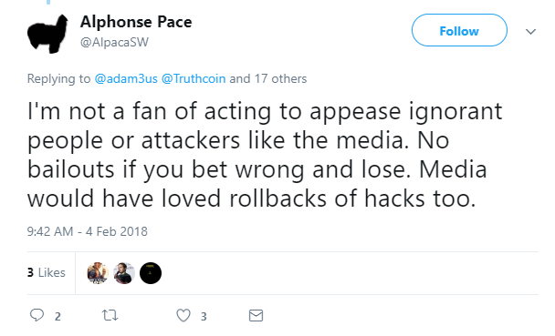
No Rollback
Liked by Giacomo Zucco, CEO Blockchainlab.it

Slide 62
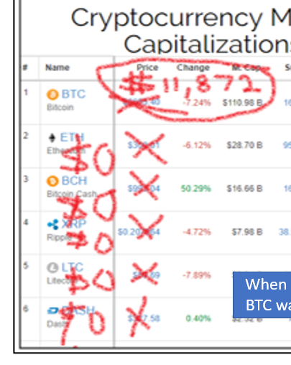
Miner Economics
Miners -- incentive to maximize exchange rate.
If sidechains good, activation → increase BTC price.
Price increase → equilibrium difficulty increase.
After difficulty increases to a certain point miners will only be able to remain profitable, if they have a 100% “support good sidechain” policy.
Does NOT mean they run sidechain nodes.
May just mean “alarm if there is ever more than one train”
Notes:
Like sovereign debt – can’t even TALK about defaulting.

Slide 63
A 51% Attack (Miner Centralization) – A Comparison
Mainchain vs Sidechain vs LN -- FYI, I think all three are secure.
With 51%, I would not attack the entire LN at once. I would attack via a mosquito strategy – where miners connect to LN-hubs and try to defraud <1% of the channels. Perhaps: 1 channel/day, or 1/hour.
 | Regular Bitcoin | Drivechain | Lightning Network
Method of Theft: | Intentional large (6+ block) chain reorganization | Advance a dishonest withdrawal 13,150 times. | Broadcast an old channel state & refuse to include fraud proof.
Proving Fraud: | Automatic (You’ll notice the reorg) | Easy (1 bit/3 months) -- DoS Resistant | Easy (auto-watch for valid, ultra-high fee, LN-channel-shaped txns)
Attack Requires 51% for…? | 7+ blocks (70 +minutes) | 13150 blocks (3 months) [ reorg 7+ blocks 70 min ] | 1000+ blocks (1 week) [ reorg 7+ blocks 70 min ]
Affects: | All main and side chains. | All sidechains. | Single individual txn.
Will Others Care? | Yes | Probably | Probably Not
Recourse: | PoW Change (Hard) | UASF (Easy) | PoW Change (Hard)
If attack succeeds: | Exchange rate falls (unreliable network); Tx-Fees fall (lower demand) | E.R. falls (token no longer multi-chain); Tx-Fees fall (no SC fees) | E.R. falls (LN unsupported); On-chain txn fees rise.
harassment
perverse incentive
Notes:
Lightning is good, and Drivechain is even better – at reducing theft. Obviously LN has greater speed and privacy, and greater scalability. But I think Drivechain is actually more secure.
Create and maintain a culture / industry where they are important, just like Ben Lawsky.
Greg Maxwell Stalin joke

Slide 64
Part 4 – Blind Merged Mining
Making Drivechain 100% opt-in, for miners as well as users.

Slide 65
Drivechain: 100% Opt In, Yet Very Easily Secure
Time
SPV
SPV
SPV
SPV
(Main) Full Node
(Main) Full Node
(Main) Full Node
(Main) Full Node

Slide 66
Opt In – Add Drivechain
Inter-chain xfers Blind Merged Mining
Time
Drivechain
Drivechain
SPV
SPV
SPV
SPV
SPV
SPV
SPV
SPV
SPV
SPV
(Side 3) Full Node
(Side 3) Full Node
(Side 2) Full Node
(Side 2) Full Node
(Main) Full Node
(Main) Full Node
(Main) Full Node
(Main) Full Node
SPV
SPV
(Side 1) Full Node
(Side 1) Full Node

Slide 67
Opt In – Sidechain Full Node is Optional
Time
SPV
SPV

Slide 68
Even Running DC-compatible software is Optional (SF)
Time
SPV
SPV

Slide 69


This is Actually Required (Remember?)
Else, we regress to the extension block – which is an Evil Fork –mainchain FULL nodes must do more validation lest they become un-FULL.
Ironically, problem with Extension Blocks is that miners can Never steal from them. At which point it becomes a full force consensus rule, and you are forced to know.

Slide 70



Even giving people an option almost certainly can’t have any effect at all … (let alone a negative one)!
…because the Altcoins (and Spinoffs) already give users those options.

Slide 71
So, no criticism is really possible…
That is fine – they are completely unaffected.
No
User runs a Sidechain Full Node?
That is fine – they have consumer sovereignty.
Yes
Ie, need to be allowed to make their own mistakes (mistakes they would make anyway by using Altcoins). Other users can always ignore these mistakes.

Slide 72
So, no criticism is really possible (?)…
Exchange rate
Tx fees
That is fine – I guess it wasn’t profitable.
No
Miner runs a Sidechain Full Node (to mine)?
That is fine?? – I guess it was profitable.
Yes
Wait a minute…

Slide 73
Network Externalities
Miners Pay?
Cost of “outsourced validation”
Always
Web wallet Phone wallet
M
Cost ($) of Full Node:
Bandwidth
Equip / CPU / Power
Storage
Rarely
Total Node Cost
Externality Full Node Cost ($):
Privacy (Observing Bandwidth)
Decentralization (Harder to Validate, fewer seed nodes)
Concentration of Power (Resource Asymmetries Become More Relevant)
Never
Miners may harm other miners.
Highly nonlinear and explosive, potentially existential!

Slide 74
Miners Imposing On Each Other
Miner may run this sidechain anyway, relying on pool.
Thus forcing *all* miners to rely on pool, as none can accord externalities.
B1
B2
B3
M
S1
S2
S3
Benefits outweigh costs, so do run the sidechain.
But “the network” (ie, other miners) is not compensated
(ie, not reimbursed)!
Sidechain shouldn’t be run – but it will be anyway.

Slide 75

Blind Merged Mining
Only affects people who run nodes, ie *not* the miners.
B1
B3
Ɛ
B2
Ɛ
Defined ‘land’ in main:coinbase -- defines the “next mined sidechain header”
OP code letting you ‘buy’ this space.
Ɛ
M
S1
S2
S3
Basically turns every sidechain full node into a pool administrator.
Market will drive Ɛ toward zero, probably even lower than the outsourced node validation cost. This effectively equalizes profits. Miners earn same profit, whether they mine a sidechain or not.
If inter-miner externalities are high, revert to Blind Merged Mining (and don’t pay them).
Gives (100-Ɛ)% fees to hashers, keeps Ɛ for themselves.
Notes:
BMM Validity unproven

Slide 76
Blind Merged Mining
Only affects people who run nodes, ie *not* the miners.
B1
B3
Ɛ
B2
Ɛ
Defined ‘land’ in main:coinbase -- defines the “next mined sidechain header”
OP code letting you ‘buy’ this space.
Ɛ
M
S1
S2
S3
More efficient than regular MM:
No software upgrade needed (miners don’t need to run new, experimental, buggy software.
Miners are paid in mainchain BTC (as opposed to sidechain coins which they may not want).
Basically turns every sidechain full node into a pool administrator.
Market will drive Ɛ toward zero, probably even lower than the outsourced node validation cost. This effectively equalizes profits. Miners earn same profit, whether they mine a sidechain or not.
Massive increase in:
decentralization,
pool competitiveness.
If inter-miner externalities are high, revert to Blind Merged Mining (and don’t pay them).
Gives (100-Ɛ)% fees to hashers, keeps Ɛ for themselves.
Pool operators cannot exclude miners.
Notes:
BMM Validity unproven

Slide 77
Disproportionately Low Support – Misunderstandings?
Dec 2013
Oct 2014
Nov 2015
Feb 2016
Oct 2016
Jan 2017
Feb/April
June
Sept
Present
2014
2015
2016
2017
2018
Sidechains
Very Old (“Drive Chain” much older than SegWit)
Solves everyone’s problems
Has zero drawbacks …
Suspicious lack of interest.
Is it Misunderstandings?

Slide 78

Helpful Comparisons
Replace “sidechain” with…
“altcoin” / “counterparty”
ecological concerns
“sidechain might become too popular”
“it would compete with Bitcoin on fees”
A website (like “Mt Gox”)
theft
“people might lose their money”
This is desirable! – Antifragility! Improvement!
Perfection neither attainable nor desirable.
Difference between DC and other things.
Timeline
“Safe Imperfection”
JihanWu-wallet.com
Notes:
Can’t prevent
XCP hides in Bitcoin txns, so it is a cat and mouse game – w/ advantage to XCP in my opinion
Also speed, transparency, verifiably
We want people to lose money if the sidechain sucks. -- how SC designs improve
A good frame for the difference in philosophy – mainchain perfect, sidechains imperfect – move fast and breaking things
Imagine if every website had to bitcoin-dev for approval, and then the people there complained – not explained enough, expl too long and tldr, don’t need – no one use.

Slide 79





Progress vs Expertise
Drivechain is pro-experiment, anti-expert.

Slide 80
Progress vs Expertise
Drivechain is pro-experiment, anti-expert.
Notes:
International conferences
Businessmen coming to ask for permission
Certainly something to think about
Even if theres no monetary compensation – its kind of cool for someone to say – Coinbase
Of course, no one will claim to be in charge explicitly,
but low interest in my Fork Futures idea – even though it killed SW2x – exactly the way I said Sep 2015
Why weren’t experts interested in killing BitcoinXT in that way
-- because it didn’t involve them.

Slide 81
Conclusion
Goals
Defeat Altcoin Competition, permanently
Resolve Scalability Conflict (“win-win”), permanently.
Resolve questions of governance. Experiments can be tried safely on opt-in basis.
Status
Code v0.1 is finished!!
Recently rebased to latest Bitcoin Core.
Help Needed
Code Review – Unclear Review Incentives
Issues are open on GitHub.
Thanks CryptAxe
Thanks Ben Goldhaber
Notes:
I don’t know if this has persuaded you to do code review or to double down on bigotry.
You know I was only trying to help,
Hero / genious
..earned – do a lot to protect Bitcoin from politicization of hard forks, threat of a mandatory extension block.
Market share below 33%, Roger Ver fighting Greg Maxwell (could be working together), Rise of Ethereum – qwerty – Esperanto – network effects – Ethereum mandatory extension blocks – government crackdown on Bitcoin
You want to roll those dice? Just think about network effects, and how dumb the average layperson is.
tearing the community apart, forcing Greg Maxwell and Roger Ver to work against each other – instead of against the banks.
Is this really our best ideas?

Slide 82
a) Misunderstandings

Slide 83




b) Racketeering
Selling the solution to a problem that you are causing.
Providers
Imagine news of a hypothetical “perfect health pill”….
Manufacturers
Researchers
…how would medical industry react?
Notes:
Policy analysts, and even documentary filmmakers. Nutritionists, personal trainers.
“Woah woah – better make sure it is perfectly safe”. “Better make sure there are no side effects”
Kind of missing the point – the upside of everyone on Earth getting perfect health a few days or weeks faster – that upside is a little more important than ensuring zero side effects. I mean what about the people who are dying of cancer now? Shouldn’t we just rush it to them immediately.

Slide 84
b) Racketeering
Reviewers / Experts /
Prestigious Consultancies
Selling the solution to a problem that you are causing.
Providers
Automatic Bitcoin Code Review process?
Imagine news of a hypothetical “perfect health pill”….
…(called “experience”).
Conference Organizers /
Twitter Groupies
Manufacturers
Two Types of Dev:
“Personal Brand” vs “Focus on Work”
Academics / Journalists
Researchers
BTC reviewers
…how would medical industry react?
Notes:
Policy analysts, and even documentary filmmakers. Nutritionists, personal trainers.
“Woah woah – better make sure it is perfectly safe”. “Better make sure there are no side effects”
Kind of missing the point – the upside of everyone on Earth getting perfect health a few days or weeks faster – that upside is a little more important than checking for side effects.
Anonymous PT story. Anonymous Blockstream story.

Slide 85

c) Virtue Signaling
Growing that Platform
Becoming more popular
Notes:
Representative of a certain archetype – the guardians of Bitcoin

Slide 86

c) Growing That Platform
Notes:
Representative of a certain archetype – the guardians of Bitcoin

Slide 87


c) Virtue Signaling
Complaints
Often vague (as if the message isn’t important)
Always in front of an audience.
Keeping us Safe…with their brave Tweets.
Cognitive Dissonance – Unearned wealth
“I care about safety the most.”
“I’m the guardian of Bitcoin.”
Vs Shaolinfry
Notes:
One Possibility – I’m a lot smarter than everyone.
Create and maintain a culture / industry where they are important, just like Ben Lawsky.

Slide 88






Bitcoin Dominance Index
d) The Altcoin Competition
Supporters of Bitcoin Core outnumbered (?) by the supporters of Alt / Multi-Token Market.
Who (secretly) owns what?
Notes:
That would explain why there’s no support from industry, despite this being the only thing that can solve the scaling contention. Many Bitcoiners, including reviewers, may already own more Altcoin than BTC.
Who knows who secretly owns what?

Slide 89




e) Politics
‘Consensus’ – inherently political.
Politics takes 20-30 points off your IQ.
“Scaling Derangement Syndrome”.
Trained to #resist hardforks.
Now Running 3rd Party!
Notes:
Ergo, everyone becomes too dumb to understand.

Slide 90

Part 4 – Response to Criticism

Slide 91

The Good – Pro-Science Culture of Extreme Criticism

Slide 92
The Bad – Ignorant People / Word Conflation
That is fine – they are completely unaffected.
No
User runs a Sidechain Full Node?
That is fine – they have consumer sovereignty.
Yes
“Theft” of funds is possible.

Slide 93
So, no criticism is really possible…

Slide 94


Notes:
https://www.reddit.com/r/Bitcoin/comments/22vn4m/why_do_people_think_that_sidechains_are_going_to/

Slide 95


Slide 96


Slide 98
Opt In – Sidechain SPV Node Optional
Time
SPV
SPV

Slide 99
Opt In – Blind Merged Mining Accurately is Optional
Time
SPV
SPV

Slide 100
Opt In – Blind Merged Mining At All is Optional
Time
SPV
SPV

Slide 101
Bitcoin Dominance Index

Slide 102

Bitcoin Dominance Index

Slide 103



Community Infighting

Slide 104
Community Infighting

